Slide 1

TRUE NEWS
RIYA RAJSHEKHAR BASALE

Slide 2
PROBLEM STATEMENT
Fake news is defined as a “particular news articles that originate either on mainstream media (online or offline) or social media and have no factual basis, but are presented as facts and not satire”.
With the widespread dissemination of information via digital media platforms, it is of utmost importance for individuals and societies to be able to judge the credibility of it.
The consequence of fake news can range from being merely annoying to influencing and misleading societies or even nations.

Slide 3
SOLUTION
True News Platform , where all the new articles are hosted , but before the article comes in contact with the public it goes through verification process to check the authenticity of the news article.
True News Platform is a decentralized platform ,achieved using the BLOCKCHAIN technology.
Every news article will be stored on the blockchain in a decentralized and distributed manner along with its proof of the news and the origin basis of the news

Slide 4
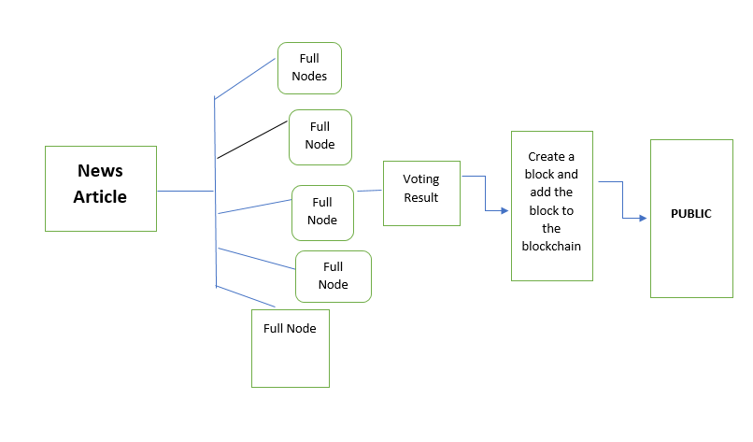

Slide 5
CONCLUSION
Creation of a decentralized platform using the BLOCKCHAIN technology, to verify and validate the news articles along with different machine approaches. To help the society get access to True News with its origin proof.

